Slide 1
NAIVE BAYES ALGORITHM

Slide 2
NAIVE BAYES
Supervised machine learning algorithm Based on Bayes’ Theorem
It assumes that the features are independent of each other – which is a naive assumption
Formula for Bayes’ Theorem:
P(A|B) = [P(B|A) . P(A)] / P(B)
P(A|B) - probability of event A happening given that B is true (posterior) P(B|A) - Probability of B given A (likelihood)
P(A) - Probability of A (prior) P(B) - Probability of B (Evidence)

Slide 3







EXAMPLE
We want to predict - “If sunny, should we play?
Step-1: Calculate prior probabilities Total Record = 5
P(play = Yes) = 3/5 = 0.6 P(play = No) = 2/5 = 0.4
Step-2: Likelihoods
P(W = Sunny|P = Yes) = How many sunny days when play
= Yes. ⟶ ⅓ = 0.33
P(W=S|P=No) = How many sunny days when play = No?
⟶ 2/2 = 1.0

Slide 4


EXAMPLE
Bayes’ Theorem:
P(p = Yes|Sunny) = P(Sunny|P=Yes).P(play=Y) / P(Sunny) P(p = No|Sunny) = P(Sunny|P=No).P(p=No) / P(Sunny)
Proportional Formula (Comparison only) P(Class|Feature) pro P(Feature|Class).P(Class)
P(p=Y|Sunny) pro P(sunny|p=Y)*P(Y) ⟶ 0.33*0.6 = 0.198 P(p=N|Sunny) pro P(sunny|p=N)*P(N) ⟶ 1.0*0.4 = 0.4
0.4>0.198
predict = No

Slide 5
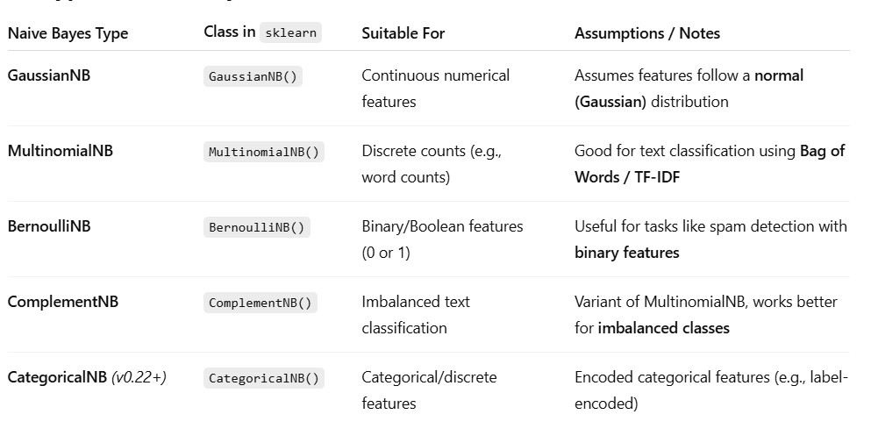
TYPES OF NAIVE BAYES CLASSIFIER

Slide 6
MCQS
Naive Bayes is based on which probability concept?
Bayes' Theorem
Pythagoras Theorem
Central Limit Theorem
Law of Large Numbers
What does the "Naive" in Naive Bayes refer to?
It is simple to implement
It assumes that all features are independent
It is a beginner algorithm
It ignores the training data
Which type of problems is Naive Bayes commonly used for?
Regression Problems
Time Series Forecasting
Classification Problems
Clustering Problems

